Slide 1


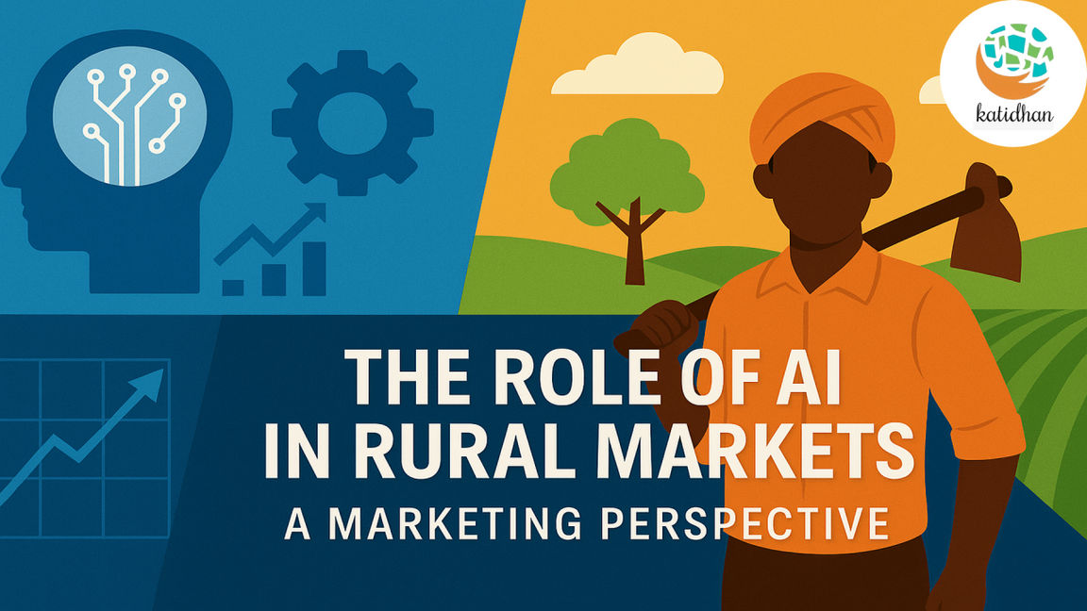

SECURIX
Project Title: Empowering Rural Vendors Through AI
Team Name: Securix
Team Members: Hariharan J, Hajumal ifran, Dharshini
Institution: J.J College of Engineering and Technology
Submission Date: July 5th ,2025

Slide 2
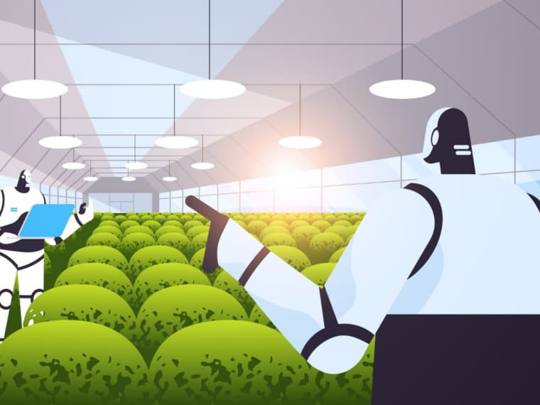
Content
01
02
03
04
05
06
07
Problem Statement
Objective
Key Features
Project Code structure
Flow chart
Conclusion
Refernces

Slide 3

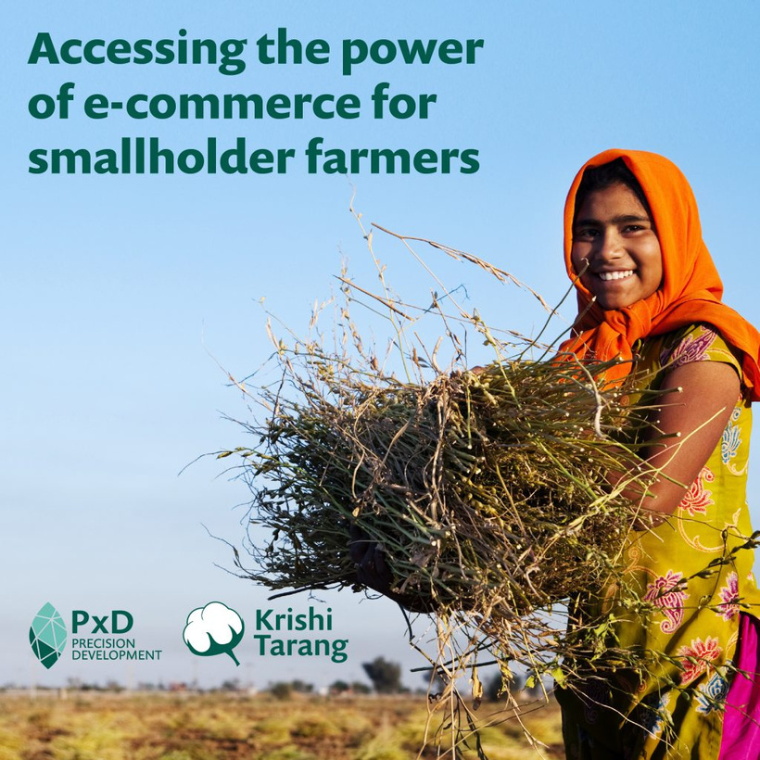
Problem statement
Rural and informal vendors lack access to digital commerce due to language barriers, low literacy, and limited technology exposure. This project solves that by enabling vendors to use voice commands in regional languages to create structured product listings using AI.

Slide 4

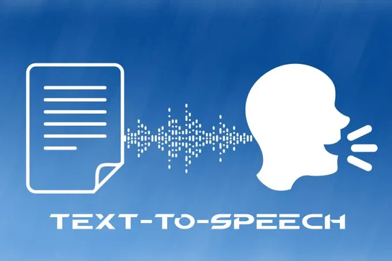
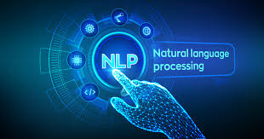
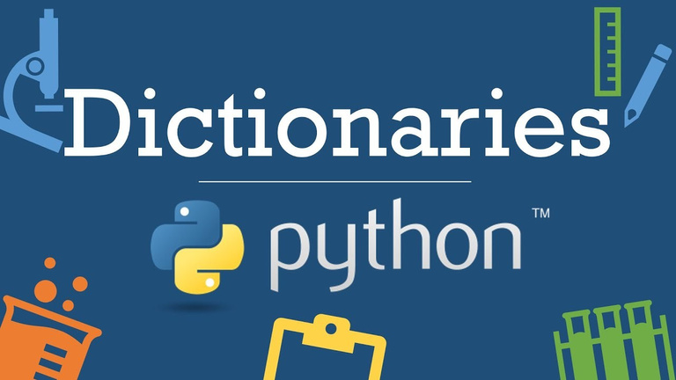
Objectives
Create a Python-based application with:
Regional language voice input support
NLP engine for product info extraction
Catalog builder to output Python dictionary
Offline-first mobile UI with no literacy needed

Slide 5



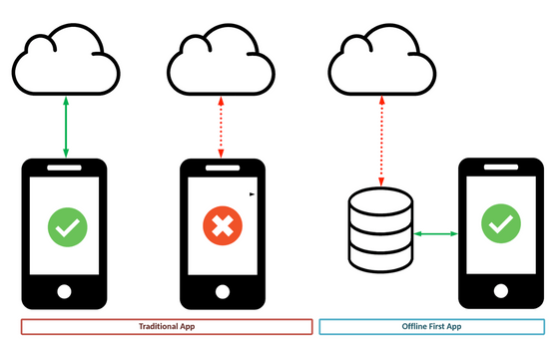
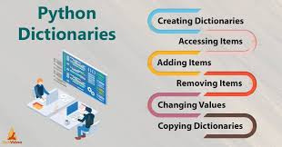
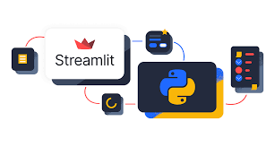
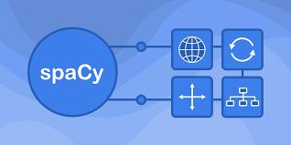
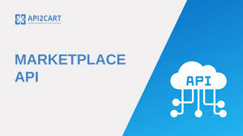
Key Features
Speech-to-Text (Google API / Whisper)
NLP Parsing using regex + spaCy
Structured product catalog as Python dictionary
Simple Streamlit UI or Android App
Offline support with Whisper + local DB
Marketplace API mock integration

Slide 6

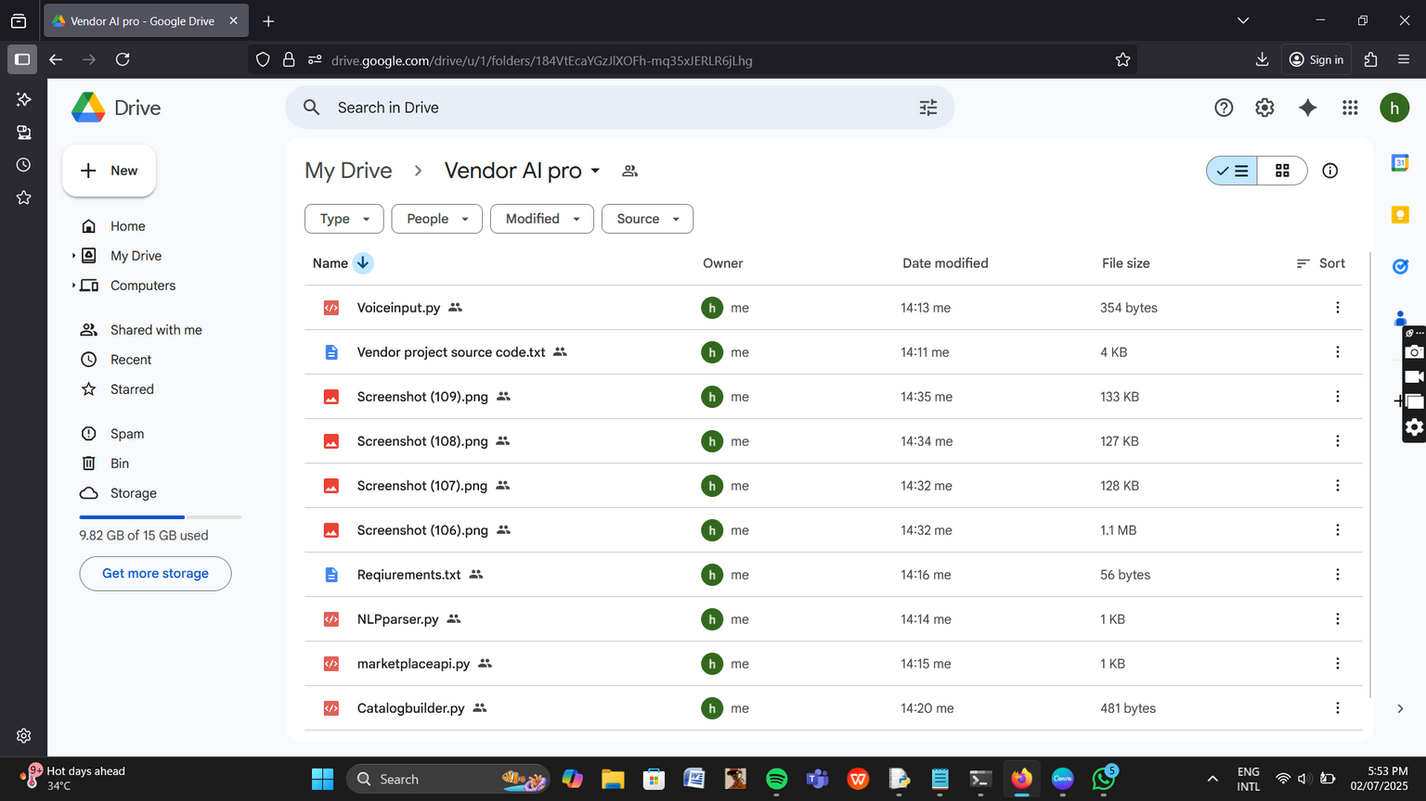
Project code Structure & POC
voice_catalog_agent/
├── app.py
# Streamlit interface
├── voice_input.py
# Google Speech-to-Text or Whisper
├── nlp_parser.py
# NLP logic for Tamil/Hindi
├── catalog_builder.py
# Dictionary structuring
├── marketplace_api.py
# Mock uploader
├── requirements.txt
# Libraries used
├── samples/
│ └── sample_audio.wav
https://drive.google.com/drive/folders/184VtEcaYGzJlXOFh-mq35xJERLR6jLhg?usp=sharing
└── data/
└── listings.db
# SQLite local storage

Slide 7
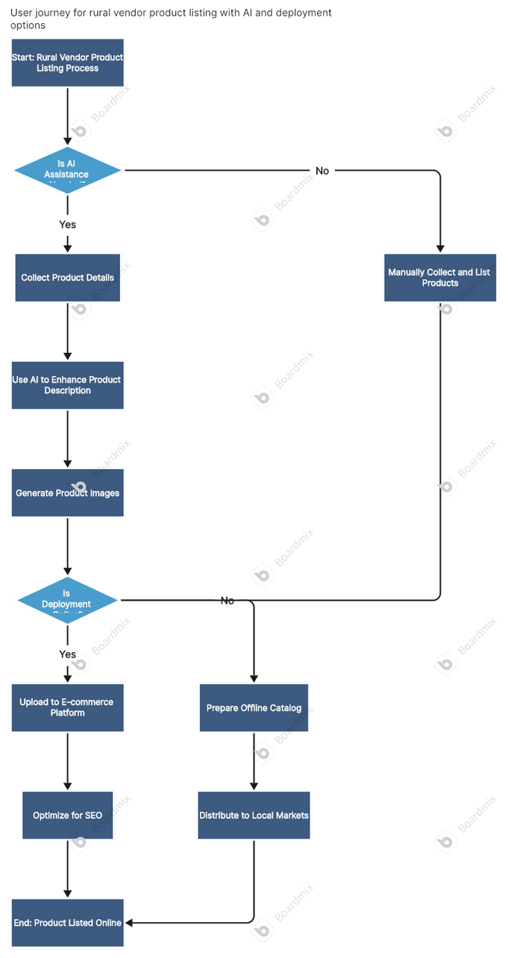
Flow Chart
The process begins with rural vendors initiating product listing, optionally supported by field staff.
A decision is made whether to use AI tools like voice recognition and LLMs for catalog automation.
If AI is used, product details are captured by voice, enhanced by AI, and optionally published online or offline.
If AI is not available, vendors manually collect, describe, and distribute product information locally.
Both paths ensure product availability, but AI offers better speed, scale, and reach.

Slide 8

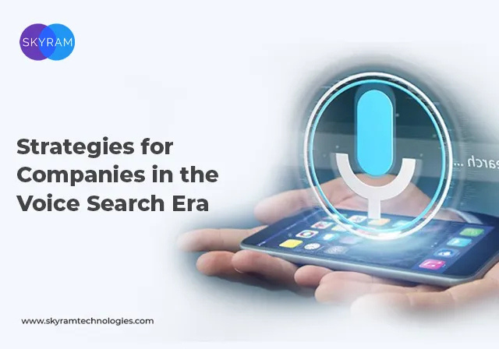
Conclusion
This solution enables voice-driven catalog creation for non-literate sellers. It can revolutionize how rural vendors join digital commerce using regional language AI.

Slide 9


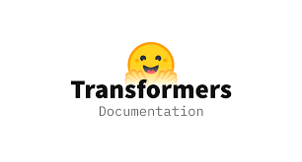



References
OpenAI Whisper – Automatic Speech Recognition
https://github.com/openai/whisper
Vosk Speech Recognition Toolkit
https://alphacephei.com/vosk/
Google Speech-to-Text API
https://cloud.google.com/speech-to-text
Hugging Face Transformers (NLP Models)
https://huggingface.co/transformers
spaCy – Industrial-strength NLP in Python
https://spacy.io/
Streamlit – Fast UI for Python Apps
https://streamlit.io/
OpenRouter – Multilingual AI Voice APIs
https://openrouter.ai/
ONDC India – Open Network for Digital Commerce
https://ondc.org/
Government of India MSME Reports
https://msme.gov.in/

